Slide 1
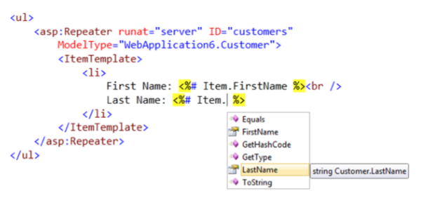








ASP.NET Data Binding
Binding UI Controls to Data Classes in Web Forms
ASP.NET Web Forms
Telerik Software Academy
http://academy.telerik.com

Slide 2


Table of Contents
Data Binding Concepts
Binding List Controls
Declarative Data Binding
Complex Data-Bound Controls
Templates and Template Controls
Container.DataItem, Eval(…) and Strongly-Typed Binding
Using GridView, FormView, DetailsView, Repeater, ListView, DataPager

Slide 3

How Data Binding Works in ASP.NET?

Slide 4
What is Data Binding?
Data binding is the process of filling data from a data source into a control
ASP.NET Web Forms controls supporting data binding have
A property DataSource
A method DataBind()
To bind a control we have to set the property DataSource and to call the method DataBind() after that
Binding is usually invoked in Page_Load()

Slide 5
Data Binding – Simple Example
Example of static list control with items:
<asp:DropDownList ID="DropDownYesNo" runat="server">
<asp:ListItem>Yes</asp:ListItem>
<asp:ListItem>No</asp:ListItem>
</asp:DropDownList>
Example of data-bound list control:
<asp:ListBox ID="ListBoxTowns" runat="server">
</asp:ListBox>
…
protected void Page_Load(object sender, EventArgs e)
{
string[] towns = { "Sofia", "Plovdiv", "Varna" };
this.ListBoxTowns.DataSource = towns;
this.ListBoxTowns.DataBind();
}

Slide 6


Data Binding: Simple Example
Live Demo

Slide 7
List-Bound Controls
Controls that are bound to a data source are called list-bound controls
ListBox, DropDownList, CheckBoxList, RadioButtonList
DataList – shows data in a template-based predefined pattern
GridView – shows data in a table
Repeater – shows data in a template designed by the programmer

Slide 8
When Does Binding Take Place?
Data binding in ASP.NET can occur:
In Page_Load() or Page_PreRender()
Sometimes Page.IsPostBack is checked
Page_Load() – called before control events
Page_PreRender() – called after control events
In an event handler:
E.g. when a button is pressed, in the ButtonLoad_Click() event handler
Data binding transfers the data from the data source to the control's internal structures

Slide 9
Sources of Data
Any class deriving from IEnumerable can be used as data source in ASP.NET Web Forms
Arrays, e.g. Town[]
Lists, e.g. List<Town>
LINQ-to-Entities query over Entity data model
LINQ-to-XML, LINQ-to-Objects queries
Etc.
ASP.NET data-source classes
EntityDataSource, ObjectDataSource, …
DataTable and DataSet classes

Slide 10
List-Bound Controls: Common Properties
To connect a list-bound controls to a data source use the properties:
DataSource
Assigns the data source
DataMember
Optionally indicates the object inside the data source: a property or a property path
E.g. DataSource = students, DataMember = Address.Town

Slide 11
Common Properties (2)
List controls (ListBox, DropDownList, CheckBoxList and RadioButtonList) have additional common properties
DataTextField – the column (property) which will be displayed on the page
E.g. CustomerName
DataValueField – the column that will provide the value for the control
E.g. CustomerID

Slide 12


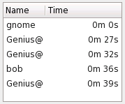
Binding List Controls

Slide 13





List Controls
Abstract class ListControl is base class for all list controls
ListBox
DropDownList
BulletedList
CheckBoxList
RadioButtonList
…

Slide 14
Binding List Controls
Common binding-related properties
DataSourceID – for declarative data binding
DataTextField – field to display
DataTextFormatString – field display format
DataValueField – field to take as result
AutoPostBack – forces postback on user click
Items – contains the list items
Common events
SelectedIndexChanged

Slide 15

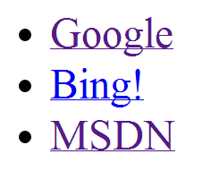

Binding List Controls – Example
<asp:BulletedList
ID="BulletedListMenu"
runat="server"
DisplayMode="HyperLink"
DataTextField="Text"
DataValueField="Url">
</asp:BulletedList>
var urls = new[]
{
new { Text="Google", Url="http://www.google.com" },
new { Text="Bing!", Url="http://www.bing.com" },
new { Text="MSDN", Url="http://msdn.microsoft.com" }
};
this.BulletedListMenu.DataSource = urls;
this.BulletedListMenu.DataBind();

Slide 16

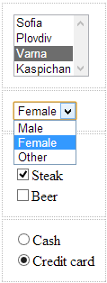



Binding List Controls
Live Demo

Slide 17
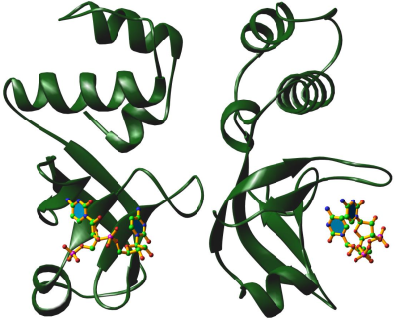
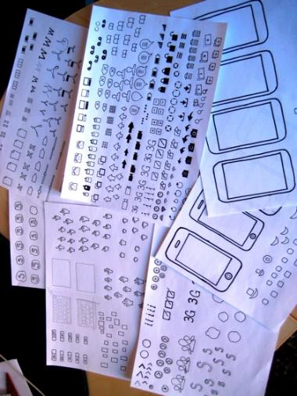

Declarative Data Binding in the ASP.NET Controls

Slide 18
Declarative Data Binding Syntax
ASP.NET Web Forms offers a declarative syntax for data-binding
Evaluated when the DataBinding event of the corresponding control is fired for each item (i.e. record / row) in the data source
The DataBinder class is used internally to retrieve the value in a column
<%#: expression %>
– binding with escaping
<%# expression %>
– unescaped binding

Slide 19
Data-Binding Syntax – Example
// Binding to a property
Customer: <%# this.CustID %>
// Binding to a collection (e.g. array)
Orders: <asp:ListBox ID="ListBoxCountries"
DataSource="<%# this.Arr %>" runat="server">
// Binding to an expression
Contact: <%#: (customer.FirstName + " " +
customer.LastName) %>
// Binding to the output of a method
Outstanding Balance: <%# GetBalance(custID) %>
// Strongly-typed binding to a collection
City: <%#: Item.Address.City.Name %>

Slide 20
How Declarative Binding Works?
Although declarative binding is similar to <% Response.Write()%> its behavior is different
Response.Write(…) is evaluated (calculated) when the page is compiled
The declarative binding syntax is evaluated when the DataBind(…) method is called
If DataBind(…) is never called, the expression <%# … %> is not displayed
During the evaluation in binding, the current data item is accessible (Container.DataItem)

Slide 21
The DataBind(…) Method
Page and all server controls have DataBind(…) method
DataBind(…) is called in a cascading order for all controls in the parent control
Evaluates all the <%# … %> expressions
DataBind(…) is usually called in the Page_Load or Page_Prerender events
void Page_Load(Object sender, EventArgs e)
{
Page.DataBind(); // Binds all control in the page
}

Slide 22
Declarative Binding – Example
<form runat="server">
<asp:DropDownList id="lstOccupation"
AutoPostBack="true" runat="server">
<asp:ListItem>Manager</asp:ListItem>
<asp:ListItem>Developer</asp:ListItem>
<asp:ListItem>Tester</asp:ListItem>
</asp:DropDownList>
<p>
You selected:
<asp:Label id="lblSelectedValue"
Text="<%#: lstOccupation.SelectedItem.Text %>"
runat="server" />
</p>
</form>

Slide 23
Strongly-Typed Binding
List controls in ASP.NET have ItemType property to specify its bound item type
Strongly-typed ASP.NET controls have the property Item at runtime of type ItemType
<asp:Repeater ID="RepeaterPeople" runat="server"
DataSource="<%# GetPeople() %>" ItemType="Person">
<ItemTemplate>
<%#: Item.FirstName %> <%#: Item.LastName %><br />
</ItemTemplate>
</asp:Repeater>

Slide 24



Declarative Binding
Live Demo

Slide 25

Complex Data-Bound Controls

Slide 26
Complex DataBound Controls
GridView
Displays a list of records as a table
Supports templates for header, body, items, …
DetailsView
Visualizes the details of a record (fields)
Supports paging, header / footer, commands
Doesn’t support templates
FormView
Like DetailsView but supports templates

Slide 27
GridView
GridView displays tabular data as HTML table
Consists of columns, header and footer
Columns can be auto-generated according to the data source or can be set explicitly
Supports paging, sorting, editing and deleting
Easy to adjust the appearance
<asp:GridView ID="GridViewCustomers" runat="server"
AutoGenerateColumns="true" AllowPaging="true" />

Slide 28
GridView Columns
Set AutoGenerateColumns to false to customize the columns in the GridView
Name | Description
BoundField | Renders a text column – data comes from the data source
ButtonField | Renders a column with buttons (Button, ImageButton or Link)
CheckBoxField | Renders a column with CheckBox (boolean data)
CommandField | Renders a column for the commands (edit, delete)
HyperLinkField | Renders a column with links in it
ImageField | Renders a column with an image. The URL comes from the data source
TemplateField | Renders a column based on an HTML template

Slide 29
GridView – Example
<asp:GridView ID="GridViewCustomers" runat="server"
AutoGenerateColumns="false">
<Columns>
<asp:BoundField DataField="FirstName"
HeaderText="First Name" />
<asp:BoundField DataField="LastName"
HeaderText="Last Name" />
<asp:BoundField DataField="Phone"
HeaderText="Phone" />
<asp:BoundField DataField="EMail"
HeaderText="E-Mail" />
<asp:CheckBoxField DataField="IsSenior"
HeaderText="Senior?" />
</Columns>
</asp:GridView>

Slide 30
GridView – Example (2)
protected void Page_Load(object sender, EventArgs e)
{
List<Customer> customers = new List<Customer>()
{
new Customer() { FirstName = “Nikolay",
LastName = “Kostov", Email = “Nikolay@Kostov.com",
Phone = "0894 77 22 53", IsSenior=true },
new Customer() { FirstName = "Bai",
LastName = “Kenov", Email = "bai.Kenov@gmail.com",
Phone = "0899 555 444" },
};
this.GridViewCustomers.DataSource = customers;
this.GridViewCustomers.DataBind();
}

Slide 31



GridView
Live Demo

Slide 32
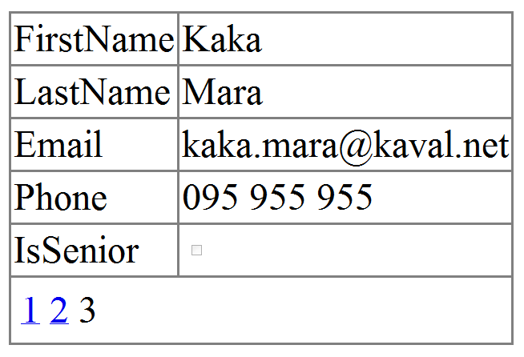
DetailsView
Displays a single record
Usually used along with GridView
Supports paging, inserting, updating, deleting
Uses the same fields as GridView
Declared in a <Fields> element
Easy to change the appearance
Can auto-generate fields:
AutoGenerateRows="true"

Slide 33
DetailsView – Example
<asp:DetailsView ID="DetailsViewCustomer"
AutoGenerateRows="true" AllowPaging="True"
runat="server" onpageindexchanging =
"DetailsViewCustomer_PageIndexChanging">
</asp:DetailsView>
protected void Page_Load(object sender, EventArgs e)
{
this.DetailsViewCustomer.DataSource = customers;
this.DetailsViewCustomer.DataBind();
}
protected void DetailsViewCustomer_PageIndexChanging(
object sender, DetailsViewPageEventArgs e)
{
this.DetailsViewCustomer.PageIndex = e.NewPageIndex;
this.DetailsViewCustomer.DataSource = customers;
this.DetailsViewCustomer.DataBind();
}

Slide 34

DetailsView
Live Demo

Slide 35
FormView
Templated version of DetailsView
Doesn’t use predefined a view
Requires the developer to define the view by using templates
Doesn’t have commands
It has mode (view, edit, insert, …)
You can use many controls for the templates – DropDownList, CheckBox, Calendar, etc.

Slide 36

FormView (2)
You are responsible to define some or all of the templates
ItemTemplate
EditItemTemplate
InsertItemTemplate
You could change the view mode at run-time:
this.FormViewCustomer.ChangeMode(FormViewMode.Edit);

Slide 37
FormView – Example
<asp:FormView ID="FormViewCustomer" runat="server"
AllowPaging="True" onpageindexchanging=
"FormViewCustomer_PageIndexChanging">
<ItemTemplate>
<%#: Eval("FirstName") %>
<%#: Eval("LastName") %>
</ItemTemplate>
</asp:FormView>
…
protected void Page_Load(object sender, EventArgs e)
{
this.FormViewCustomer.DataSource = this.customers;
this.FormViewCustomer.DataBind();
}

Slide 38



FormView
Live Demo

Slide 39
The TreeView Control
TreeView is a fully functional control used to display hierarchical data
Allows multiple visual adjustments
Node images, fold and expand images, connecting lines, checkboxes
Supports navigation and postback
You can create nodes declaratively or in code
We can fill nodes dynamically from the server when needed (when the data is too much)

Slide 40
Repeater
GridView doesn’t give you full control
Uses HTML tables (<table>)
The Repeater control is the most flexible control to show a sequence of data rows
Template-based visualization
You write the HTML visualization code yourself
Useful when you want to implement a non-standard visualization of read-only data
The output code is manually written

Slide 41


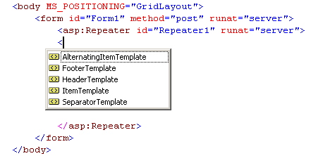
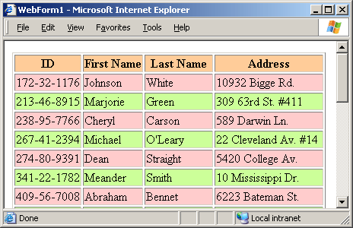
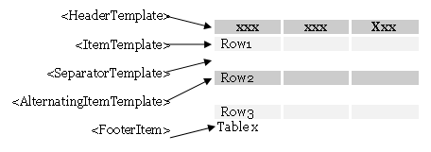
Repeater: How to Use It?

Slide 42

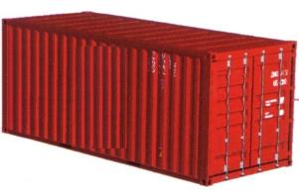

Templates, Eval(…) and Strongly-Typed Binding

Slide 43
Templates
The GridView, Repeater and FormView offer rich customization based on templates
Data templates
Display data in highly-customizable fashion
Format the appearance of data
Eval(expression) or Item (in strongly-typed binding) provide access to the current item
The current data-bound item is accessible through the Container.DataItem

Slide 44
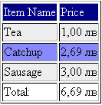
Templates (2)
<HeaderTemplate>
<ItemTemplate>
<AlternatingItemTemplate>
<FooterTemplate>
Example:
<AlternatingItemTemplate>
<tr style="background: #8888FF">
<td><%#: Eval("ItemName") %></td>
<td><%#: Eval("Price", "{0:c}") %></td>
</tr>
</AlternatingItemTemplate>

Slide 45
Accessing the Current Item
Accessing at runtime the current item from the data source collection (IEnumerable):
Container.DataItem
Gets the current item as object
DataBinder.Eval(container, expression, [format])
Evaluates an expression through reflection
Slower than Container.DataItem
Just use Eval(expression) as shortcut

Slide 46
DataBinder.Eval() vs. Container. DataItem vs. Eval() vs. Item.Prop
// Using Container.DataItem
<%#: String.Format("{0:c}", ((DataRowView)
Container.DataItem)["SomeIntegerField"])%>
// Using DataBinder.Eval(…)
<%#: DataBinder.Eval(Container.DataItem,
"SomeIntegerField", "{0:c}") %>
// Using Eval(…)
<%#: Eval("SomeIntegerField", "{0:c}") %>
// Using Item.PropertyPath (strongly-typed)
<%#: Item.Address.Town.ID %>

Slide 47
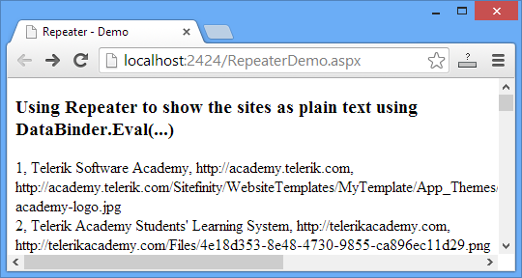
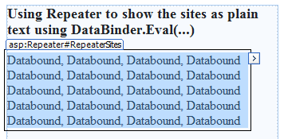
Repeater – Example
<asp:Repeater id="RepeaterSites" runat="server">
<ItemTemplate>
<%#: DataBinder.Eval(Container.DataItem, "Id") %>,
<%#: DataBinder.Eval(Container.DataItem, "Name") %>,
<%#: DataBinder.Eval(Container.DataItem, "URL") %>,
<%#: DataBinder.Eval(Container.DataItem, "ImageURL") %>
</ItemTemplate>
</asp:Repeater>

Slide 48
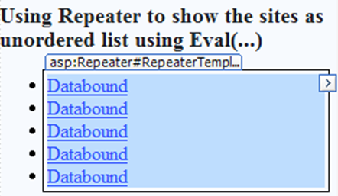
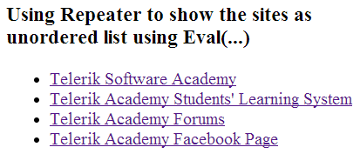
Repeater – Example (2)
<asp:Repeater id="RepeaterTemplatedList" runat="server">
<HeaderTemplate>
<ul>
</HeaderTemplate>
<ItemTemplate>
<li>
<a href="<%#: Eval("URL") %>">
<%#: Eval("Name") %>
</a>
</li>
</ItemTemplate>
<FooterTemplate>
</ul>
</FooterTemplate>
</asp:Repeater>

Slide 49
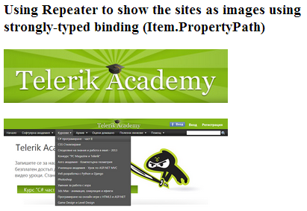
Repeater – Example (3)
<asp:Repeater ID="RepeaterImages" runat="server"
ItemType="Site">
<ItemTemplate>
<p><a href='<%#: Item.URL %>'> <img src='<%#: Item.ImageURL %>' border="0"
alt='<%#: Item.Name %>' /></a></p>
</ItemTemplate>
</asp:Repeater>

Slide 50


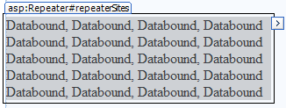
Using Repeater with Templates
Live Demo

Slide 51
ListView
ListView is an extremely flexible data-bound control for displaying lists and tables
Works similarly to GridView
Adds higher-level features
Selection, inserting and editing
More extensive set of templates than GridView
Supports paging (through DataPager)
Groups can display items in tiles (using GroupTemplate and GroupItemCount)

Slide 52
ListView – Templates
ItemTemplate – sets the content of every data item
ItemSeparatorTemplate
SelectedItemTemplate
EditItemTemplate, InsertItemTemplate
GroupTemplate
EmptyItemTemplate
and etc.

Slide 53
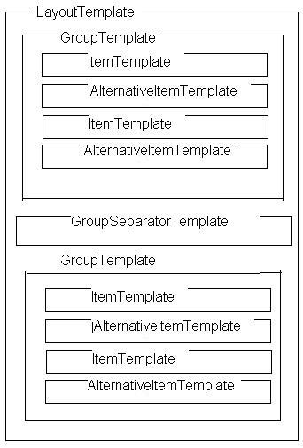
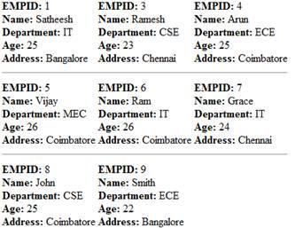
ListView – Templates and Groups

Slide 54

DataPager
DataPager gives you a single, consistent way to use paging with a variety of controls
The ListView is the only control that supports the DataPager
Pager Fields
NextPreviousPagerField
NumericPagerField
TemplatePagerField

Slide 55



ListView and DataPager
Live Demo

Slide 56
Using multiple controls
<asp:DropDownList runat="server“ ID="DropDownListCategory" OnSelectedIndexChanged=“ddlCategory_Changed“
AutoPostBack="true">
<asp:ListItem>all</asp:ListItem> </asp:DropDownList>
<asp:DropDownList runat="server“ ID="DropDownListBrand" OnSelectedIndexChanged=“ddlCategory_Changed">
<asp:ListItem>all</asp:ListItem>
</asp:DropDownList>
protected void ddlCategory_Changed(object sender, EventArgs e)
{
DropDownList listView = sender as DropDownList;
string selectedCategory = listView.SelectedValue;
this.ListViewCars.DataSource =
GetBrandsByCategory(selectedCategory);
this.ListViewCars.DataBind();
}

Slide 57
ASP.NET Data Binding
http://academy.telerik.com

Slide 58
Homework
Create a Web form for searching for cars by producer + model + type of engine + set of extras (see www.mobile.bg). Use two DropDownLists for the producer (e.g. VW, BMW, …) and for the model (A6, Corsa,…). Create a class Producer hodling Name + collection of models. Bind the list of producers to the first DropDownList. The second should be bound to the models of this producer. You should have a check box for each “extra” (use class Extra and bind the list of extras at the server side). Implement the type of engine as a horizontal radio button selection (options bound to a fixed array). On submit display all collected information in <asp:Literal>.

Slide 59
Homework (2)
Create a page Employees.aspx to display the names of all employees from Northwind database in a GridView as hyperlinks. All links should redirect to another page (e.g. EmpDetails.aspx?id=3) where details about the employee are displayed in a DetailsView. Add a back button to return back to the previous page.
Implement the previous task in a single ASPX page by using a FormView instead of DetailsView.
Display the information about all employees a table in an ASPX page using a Repeater.
Re-implement the previous using ListView.

Slide 60
Homework (3)
* Create a Web Form that reads arbitrary XML document and displays it as tree. Use the TreeView Web control on the left side to display the inner XML of the selected node on the right side.
* Create a Web Form that shows in a table the names, country and city of all employees from the Northwind database. Implement paging (10 employees on each page) and sorting by each column. Using AJAX, JavaScript and jQuery on mouse over display a popup DIV with additional info about the employee: photo, phone, email, address, notes. On mouse out hide the additional info.

Slide 61



Free Trainings @ Telerik Academy
"Web Design with HTML 5, CSS 3 and JavaScript" course @ Telerik Academy
html5course.telerik.com
Telerik Software Academy
academy.telerik.com
Telerik Academy @ Facebook
facebook.com/TelerikAcademy
Telerik Software Academy Forums
forums.academy.telerik.com

